Slide 1
Seismometer Position Optimization for Newtonian Noise Mitigation in the Einstein Telescope
Patrick Schillings and Johannes Erdmann — RWTH-Aachen University, Aachen, Germany
07.03.2024 - Karlsruhe

Slide 2
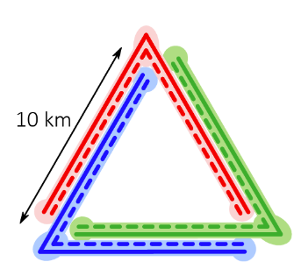
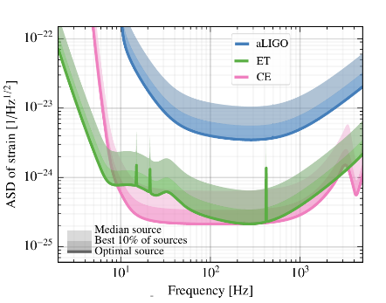
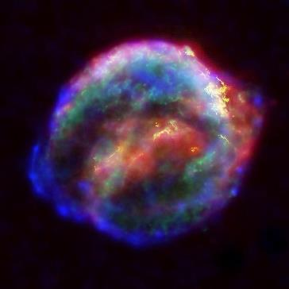
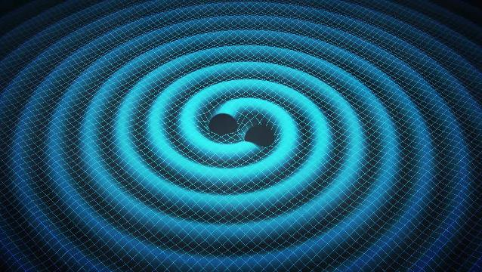
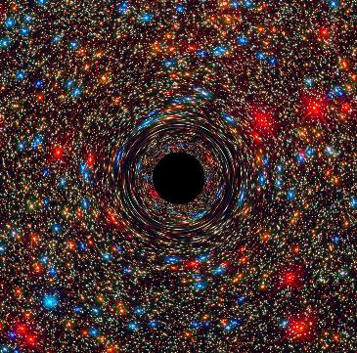
The Einstein Telescope
[1]
[1]
[ET]: ET-0007B-20
[2a]
[3]
[2b]

Slide 3
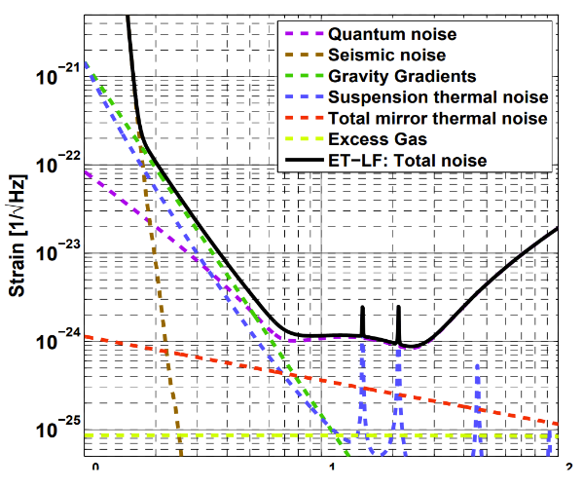
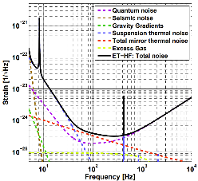
Where is my topic in the Einstein telescope
[Hild et a.]: arXiv:1012.0908
[1]

Slide 4
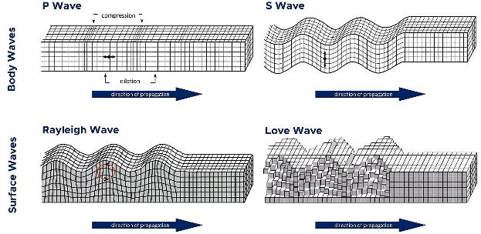
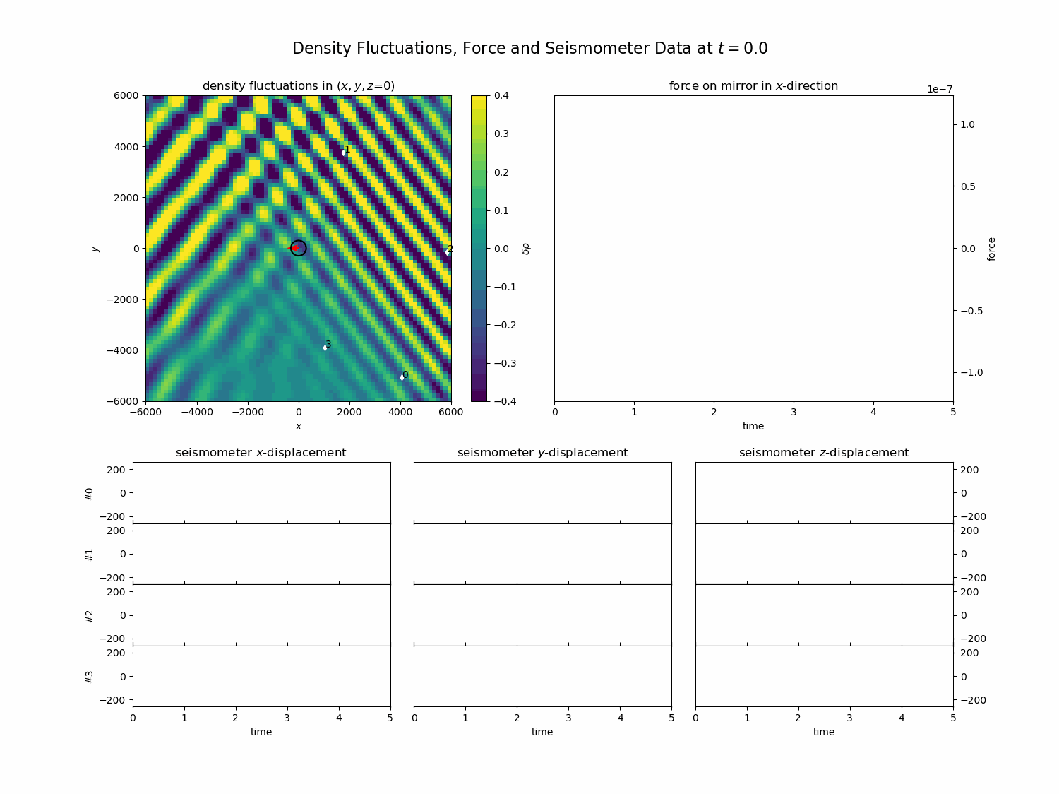
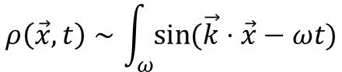
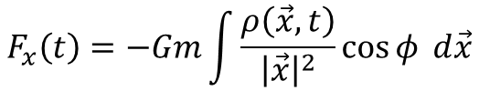
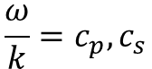
Newtonian Noise
$$ρ\left(\vec{x},t\right)∼\int_{ω}{sin}{(\vec{k}⋅\vec{x}−ωt)}$$
[4]
$$F_{x}\left(t\right)=−Gm\int{\frac{ρ\left(\vec{x},t\right)}{{\left|\vec{x}\right|}^{2}}\cos{φ} d\vec{x}}$$
$$\frac{ω}{k}=c_{p}, c_{s}$$
[C. Ammons et a.]: “Foundations of Modern Global Seismology”
[S.Hughes & K. Thorne]: arXiv:gr-qc/9806018

Slide 5
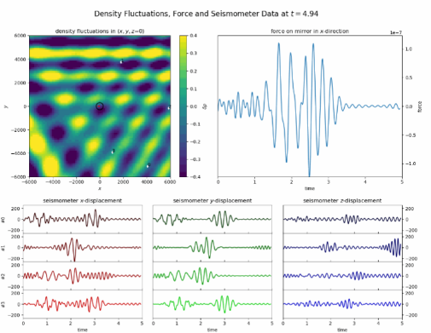
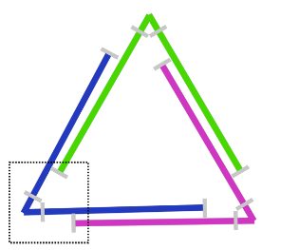

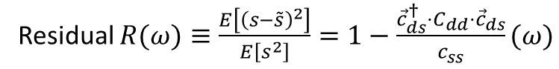
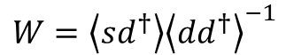
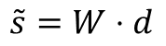
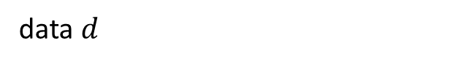
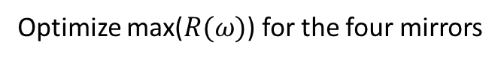
Wiener Filter
[F. Badaracco & J. Harms]: arXiv:1903.07936
[F. Badaracco et a.]: arXiv:2310.05709
signal $s$
$$\tilde{s}=W⋅d$$
$$W=\left\langle sd^{†}\right\rangle {\left\langle dd^{†}\right\rangle }^{−1}$$
Residual $R(ω)≡\frac{E\left[{\left(s−\tilde{s}\right)}^{2}\right]}{E\left[s^{2}\right]}=1−\frac{{\vec{c}}_{ds}^{†}⋅C_{dd}⋅{\vec{c}}_{ds}}{c_{ss}}(ω)$
[5]
Assumptions: homogeniety, isotropy, plain waves
data $d$
Optimize max($R(ω)$) for the four mirrors

Slide 6
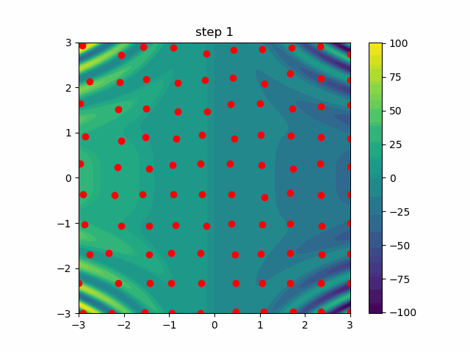
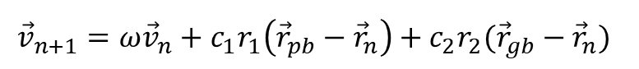
Particle Swarm Optimization
For each particle:
$${\vec{v}}_{n+1}=ω{\vec{v}}_{n}+c_{1}r_{1}\left({\vec{r}}_{pb}−{\vec{r}}_{n}\right)+c_{2}r_{2}({\vec{r}}_{gb}−{\vec{r}}_{n})$$
Quick!
Works in high dimensions
No need for differentiability
Finds good optima?
[J. Kennedy & R. Eberhart]: “Particle swarm optimization”

Slide 7
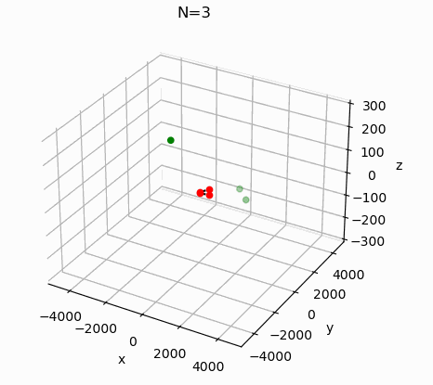
Results
Original Code by Francesca Badaracco et a., arXiv:2310.05709
Problem parameters:
Number of Seismometers N (15)
Signal-to-Noise-Ratio of operating seismometers SNR (15)
Optimization frequency f (1 Hz)
Ratio of P- and S-waves p (0.2)

Slide 8
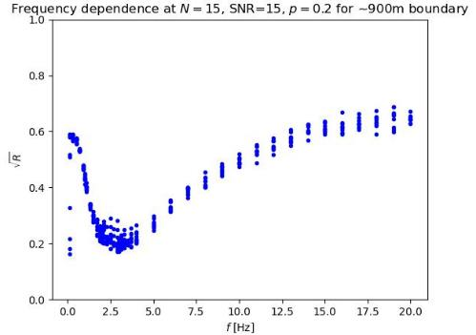
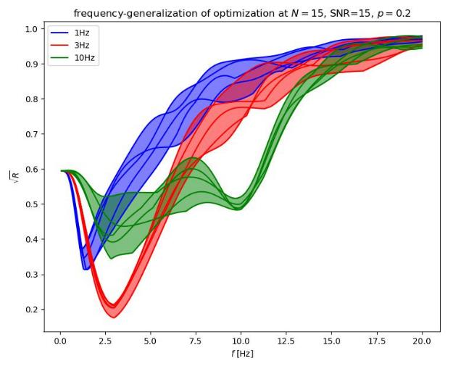
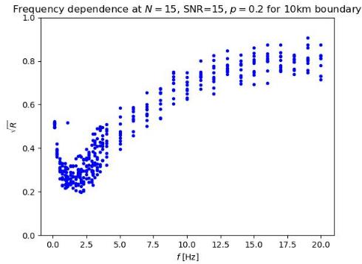
Frequency dependency

Slide 9
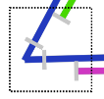
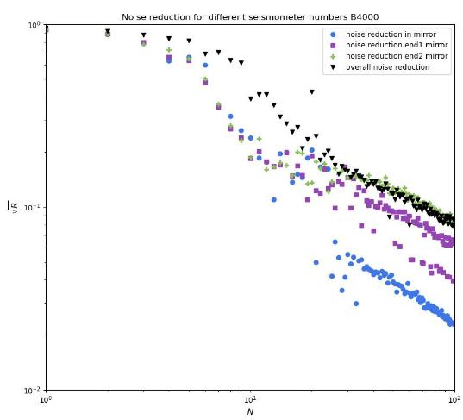
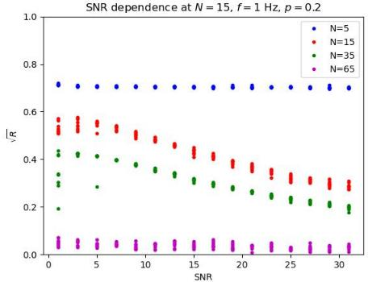
SNR and N dependency
end2 +
in ●
end1 ■

Slide 10
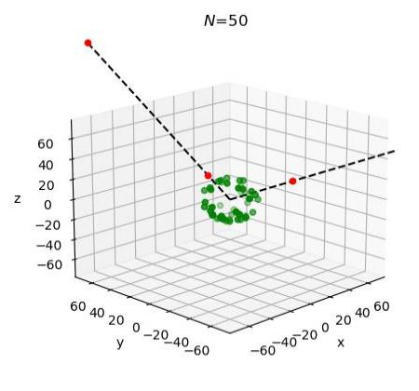
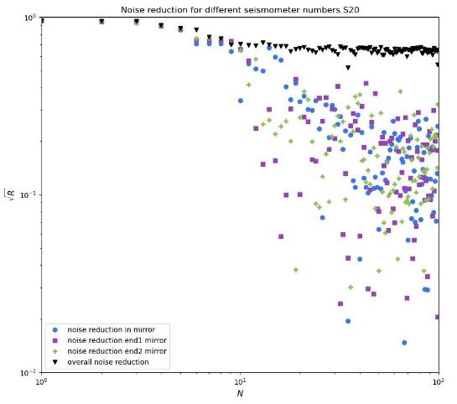
Spherical Cavern
end2 +
in ●
end1 ■

Slide 11
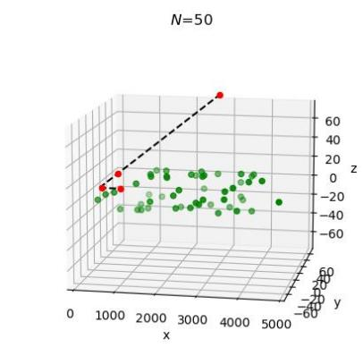
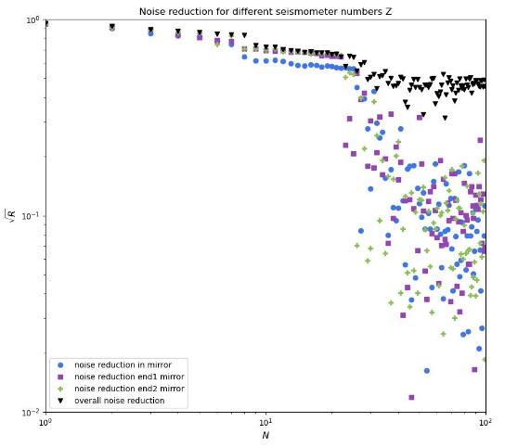
Cylindrical Cavern
end2 +
in ●
end1 ■

Slide 12
Outlook
Cost function
Compare optimizations methods
Plane-waves → wave packages
Isotropy → realistic arrival directions
Homogeniety → realistic geological model
Neural Networks
Real-time calculations

Slide 13
Image Sources
[1] ET Steering Committee. Einstein Telescope design report update 2020. available from European Gravitational Observatory, document number ET-0007B-20, 2020.
[2] NASA/ESA [a]Johns Hopkins University [b] D. Coe, J. Anderson, and R. van der Marel
[3] Swinburne Astronomy Productions
[4] Bolt, B.A. Inside the Earth: Evidence from Earthquakes; W. H. Freeman & Co.: San Francisco, CA, USA, 1982 (Modified by Bačić et a., 2015 and Luke Triton)

Slide 14
Image Sources (2)
[5] Francesca Badaracco, Jan Harms, and Luca Rei. Joint optimization of seismometer arrays for the cancellation of newtonian noise from seismic body waves in the einstein telescope. Classical and Quantum Gravity, 41(2):025013, jan 2024.6

